Slide 1
Day 3 of #100daysofmathandstats:
Estimates of Location
By Harsh Kathiriya

Slide 2

Mean
The most basic estimate of location is the mean, or average value.

Slide 3

Trimmed mean
A variation of the mean is a trimmed mean, which you calculate by dropping a fixed number of sorted values at each end and then taking an average of the remaining values

Slide 4

Weighted mean
Another type of mean is a weighted mean, which is calculated by multiplying each observation with corresponding weight.

Slide 5
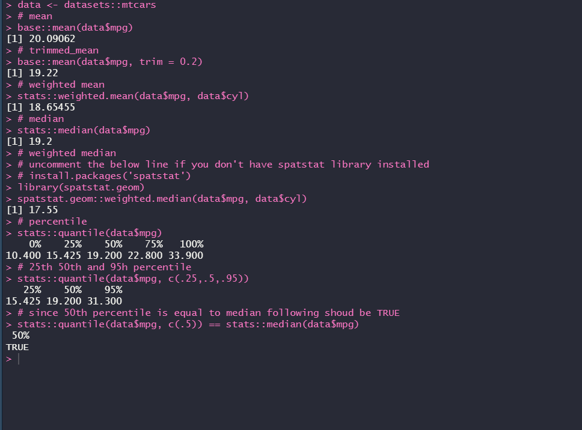
R implementation

Slide 6
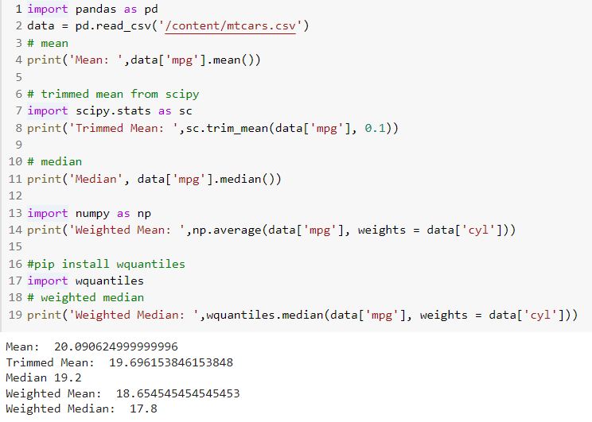
Python implementation

Slide 7
Thank you
Don’t forget to post your questions and feedbacks on the post.

